Slide 1
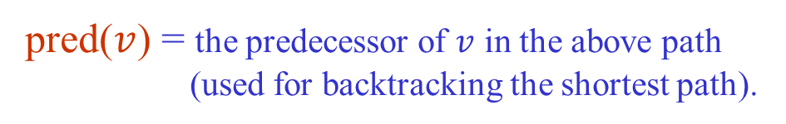
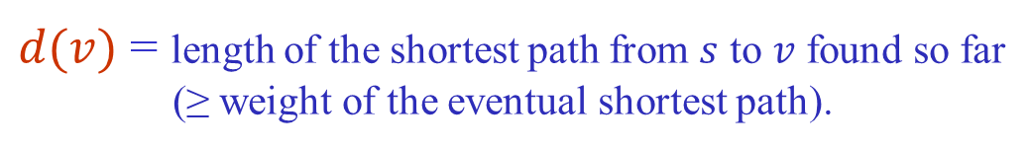
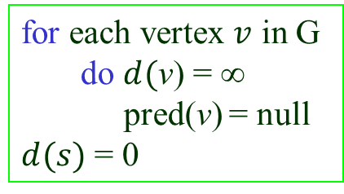
Representing Shortest Paths
During the execution of a shortest-path algorithm, maintain
two maps:
$d(v)$ = length of the shortest path from $s$ to $v$ found so far
(≥ weight of the eventual shortest path).
pred($v$) = the predecessor of $v$ in the above path
(used for backtracking the shortest path).
Initialization
for each vertex $v$ in G
do $d($v) = ∞
pred(v) = null
$d(s)$ = 0

Slide 2



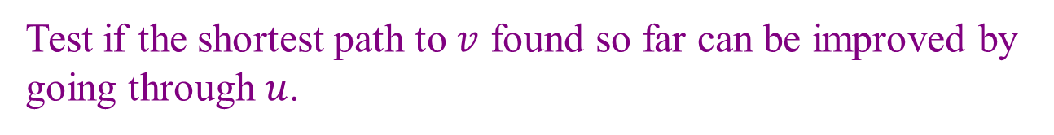


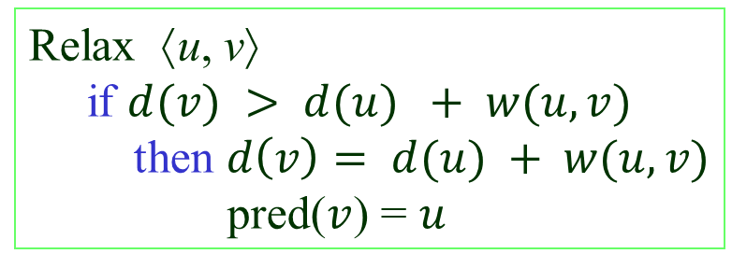


Edge Relaxation
Test if the shortest path to $v$ found so far can be improved by
going through $u$.
$$u$$
$$s$$
$$v$$
w
pred(v)
Relax ⟨u, v⟩
if $d(v) > d(u) + w(u, v)$
then $d\left(v\right)= d(u) + w(u, v)$
pred($v$) = $u$
$$d(v) > d(u) + w(u, v)$$
u
pred(v)
Shortest path algorithms differ in
the number of times the edges are
relaxed and the order in which they
are relaxed.
$$s$$
$$v$$
$$w$$

Slide 3
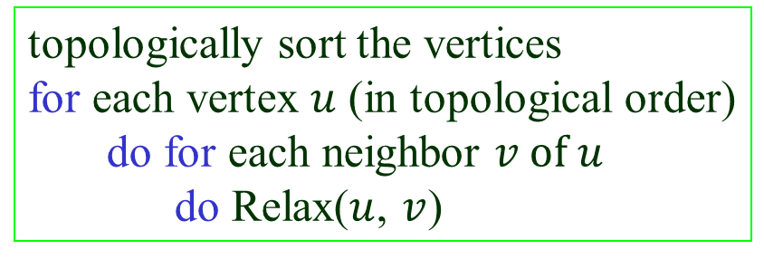

Shortests Paths in DAGs
When the graph is a directed acyclic graph (DAG), relax
edges according to a topological ordering of vertices.

Slide 4
An Example
9
5
r
∞
∞
y
3
6
2
∞
∞
3
4
x
z
s
0
9
1
∞
t
Topological order: s, r, y, x, z, t

Slide 5
9
5
r
∞
2
y
3
6
2
3
∞
3
4
x
z
s
0
9
1
9
t
Topological order: s, r, y, x, z, t
Relax edges ⟨s, r⟩, ⟨s, x⟩, ⟨s, t⟩.

Slide 6
9
5
r
7
2
y
3
6
2
3
11
3
4
x
z
s
0
9
1
9
t
Topological order: s, r, y, x, z, t
Relax edges ⟨r, x⟩, ⟨r, y⟩, ⟨r, z⟩.

Slide 7
9
5
r
7
2
y
3
6
2
3
10
3
4
x
z
s
0
9
1
9
t
Topological order: s, r, y, x, z, t
Relax edge ⟨y, z⟩.

Slide 8
9
5
r
7
2
y
3
6
2
3
7
3
4
x
z
s
0
9
1
9
t
Topological order: s, r, y, x, z, t
Relax edge ⟨x, z⟩.

Slide 9
Finish
9
5
r
7
2
y
3
6
2
3
7
3
4
x
z
s
0
9
1
8
t
Topological order: s, r, y, x, z, t
Relax edge ⟨z, t⟩.

Slide 10



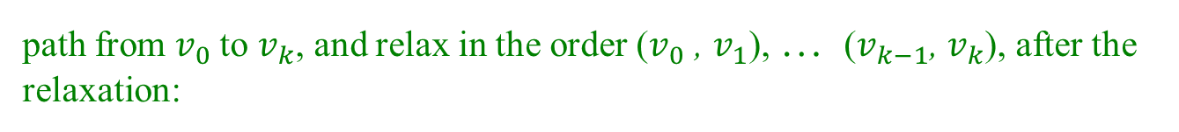

Correctness
Path relaxation property: If is a shortest
$$v_{0}$$
$$v_{1}$$
$$v_{k}$$
path from $v_{0}$to $v_{k}$, and relax in the order ($v_{0}$ , $v_{1}$), … ($v_{k−1}$, $v_{k}$), after the
relaxation:
$d(v_{k})$ stores the shortest path length
pred$(v_{k})$ stores the predecessor on the shortest path.
The topological order guarantees that edges on every path from the
source will be relaxed in the order in which they appear on the path.
Thus, the path relaxation property is satisfied and the algorithm
works correctly.

Slide 11
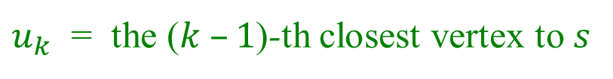
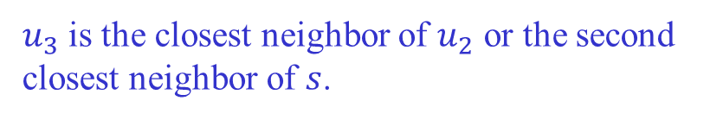



Dijkstra’s Algorithm
Applicable when all edge weights are non-negative.
Idea: Successively compute $u_{1}$, $u_{2}$, …, $u_{n}$, where
$u_{k}$ = the ($k –1$)-th closest vertex to $s$
Greedy strategy (same as breadth-first search if all weights are 1):
$$u_{1}= s$$
$u_{2}$is the closest neighbor of $s$; i.e.,
$w(s, u_{2}) = min⁡\{ w(s,v) |$⟨$s, v in E \}$
$u_{3}$ is the closest neighbor of $u_{2}$ or the second
closest neighbor of $s$.
...

Slide 12
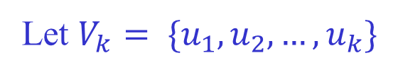

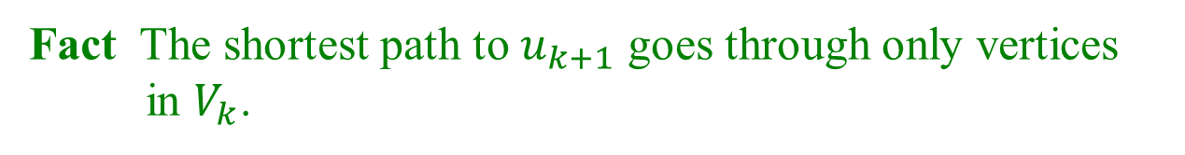



How to Find the Next Closest?
Let $V_{k}= \{u_{1},u_{2},…,u_{k}\}$
$u_{k+1}$ is the vertex with minimum $d$-value in $V\left(G\right)− V_{k}$.
Fact The shortest path to $u_{k+1}$ goes through only vertices
in $V_{k}$.
Suppose there exists a vertex $x$ not in $V_{k}$but on the shortest path to $u_{k+1}$.
$$V_{k}$$
$u_{k+1}$
$$s$$
$$x$$
Then $x$ is closer to $s$ than $u_{k+1}. It should have been included in{ V}_{k}$.

Slide 13
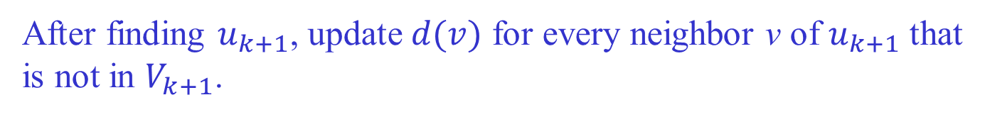


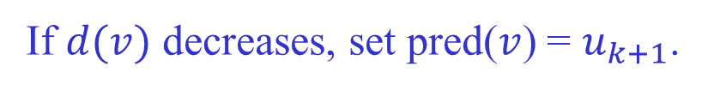


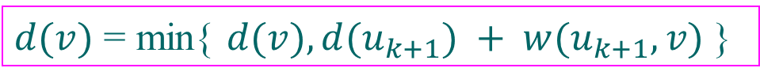

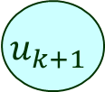
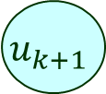


Relaxation
After finding $u_{k+1}$, update $d(v)$ for every neighbor v of $u_{k+1}$ that
is not in $V_{k+1}$.
$$V_{k}$$
$$V_{k+1}$$
$$u_{k+1}$$
$$u_{k+1}$$
$$s$$
$$s$$
$$x$$
$$x$$
$$v$$
$$v$$
$d(v)$ = min{ $d(v), d(u_{k+1}) + w(u_{k+1}, v)$}
If $d(v)$ decreases, set pred($v$) = $u_{k+1}$.

Slide 14
An Example
∞
∞
a
7
d
2
5
2
∞
4
5
b
1
f
s
3
∞
0
1
7
4
e
c
4
∞
∞
$u_{k+1}$ is the vertex with minimum $d$-value in $V\left(G\right)− V_{k}$.

Slide 15
k
2
7
∞
a
d
2
5
2
5
4
5
b
1
f
s
3
∞
0
1
7
4
e
c
4
∞
4

Slide 16
2
9
a
7
d
2
5
2
4
4
5
b
1
f
s
3
∞
0
1
7
4
e
c
4
∞
4

Slide 17
2
8
a
7
d
2
5
2
4
4
5
b
1
f
s
3
∞
0
1
7
4
e
c
4
7
4

Slide 18
2
8
a
7
d
2
5
2
4
4
5
b
1
f
s
3
∞
0
1
7
4
e
c
4
7
4

Slide 19
2
8
a
7
d
2
5
2
4
4
5
b
1
f
s
3
14
0
1
7
4
e
c
4
7
4

Slide 20
2
8
a
7
d
2
5
2
4
4
5
b
1
f
s
3
13
0
1
7
4
e
c
4
7
4

Slide 21
2
8
a
7
d
2
5
2
4
4
5
b
1
f
s
3
13
0
1
7
4
e
c
4
7
4

Slide 22
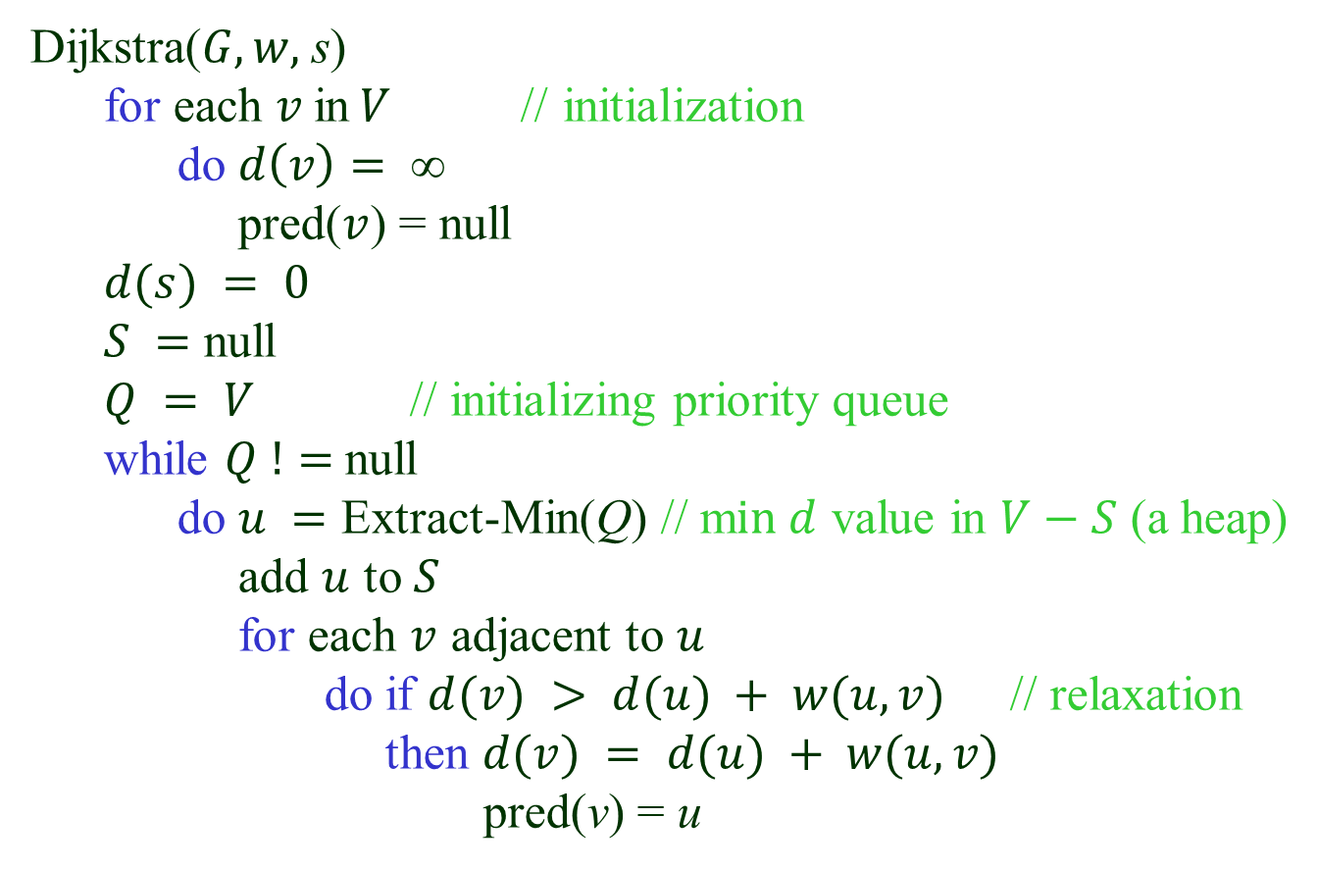
Algorithm Description
Dijkstra($G, w,$s)
for each $v$in$V$// initialization
do $d\left(v\right)= $
pred($v$) = null
$d(s) = 0$
$S =$ null
$Q = V$ // initializing priority queue
while $Q !=$null
do $u =$ Extract-Min(Q) // m$in d$ value in $V−S$ (a heap)
add $u$ to $S$
for each $v$ adjacent to $u$
do if $d(v) > d(u) + w(u, v)$// relaxation
then $d(v) = d(u) + w(u, v)$
pred(v) = u

Slide 23
Analysis
$Q$ build-queue extract-min decrease-key total
#operations 1 |V | |E|
Array $O(|V|) O(|V|) O(1) O({|V|}^{2})$
Heap $O(|V|) O(log⁡|V|) O(\log\left|V\right|) O(|E|\log{|V|})$

Slide 24
What We’ve Learned from 228
Java
Algorthms & Analysis
♦ Inheritance & abstraction
♥ Big-O
♦ Interface vs abstract class
♥ Binary search
♦ Dynamic binding
♥ Sorting
♦ Method overriding
• Selection sort
♦ Cloning, shallow vs deep copying
• Insertion sort
♦ Generic programming
• Mergesort
♦ Wild cards
• Quicksort
Data structures
• Heap sort
♣ Linked lists (singly, doubly, circular)
♥ Infix & postfix conversions
♣ Stacks
♥ Graham’s scan & Javis’ march
♣ Trees (general, binary, expression, BSTs, splay)
♥ Tree travesals
♣ Sets & maps
♣ Hash tables
♥ BFS & DFS
♣ Heaps
♥ Topological sort
♣ Graphs
♥ Dijkstra’s algorithm

